Slide 1

Department of Computer Science and Engineering Unveiling the potential of Deep Learning: A Multifaceted Approach to Pulmonary Disease Detection and Clinical Integration
PRESENTED BY
Gurram Siva Anjali (21471A0526.)
Pandi Jyoshna Devi (21471A0542.)
Gude Lavanya (21471A0524.)
Under the Guidance of,
Dr. K. LakshmiNadh _{M.Tech., Ph.D.}
Professor,
Department of Computer Science and Engineering,
Narasaraopeta Engineering College (Autonomous),
Narasaraopet- 522 601.
10-03-2025 Review No.2 Batch No.AG1 Department of CSE

Slide 2
OUTLINE
Abstract
Introduction
Literature Survey
Research Gaps
Problem Statement
Objectives
Block Diagram / Flow Diagram
Methodology
Implementation
Challenges
Result and Analysis
Conclusion and Future Scope
References
Acknowledgements
10-03-2025 Review No.2 Batch No.AG1 Department of CSE

Slide 3
ABSTRACT
Pulmonary diseases are hard to diagnose and treat because of their complexity, but deep learning offers new possibilities. This project focuses on improving diagnosis for viral pneumonitis, bacterial pneumonitis, COVID-19, and normal lungs using advanced AI models called Convolutional Neural Networks (CNNs). These models analyze chest X-rays and CT scans to identify subtle patterns linked to these diseases. Rigorous testing shows better early detection and fewer errors, highlighting the potential of AI in healthcare. The project also explores how AI can be integrated into current medical practices while addressing challenges like patient privacy, transparency in AI decisions, and training for healthcare professionals. This work shows how AI can transform pulmonary disease diagnosis and improve clinical care.
10-03-2025 Review No.2 Batch No.AG1 Department of CSE

Slide 4
INTRODUCTION
AI in Pulmonary Disease Diagnosis: Deep learning enhances accuracy and efficiency in diagnosing complex diseases like tuberculosis, viral and bacterial pneumonia, and COVID-19, addressing the limitations of traditional methods.
Integrated Data Approach: Combines radiographic images processed by CNNs with clinical data (e.g., FVC, FEV1) using normalization and encoding techniques, enabling holistic predictions.
Model Design & Performance: A unified model merges visual and clinical data, evaluated using metrics like AUC and ROC for robust performance analysis.
AI Integration in Healthcare: Ensures explainability with Grad-CAM, protects patient privacy through anonymization, and provides training for healthcare professionals to adopt AI-driven diagnostics.
10-03-2025 Review No.2 Batch No.AG1 Department of CSE

Slide 5
LITERATURE SURVEY
No | Title | Author | Journal Name & Year | Methodology Adapted | Key Findings | Gaps
1 | PulmoNet: a novel deep learning based pulmonary diseases detection model. | Abdul Rahman Tosho Abdulahi | BMC Medical Imaging & 2024 | PulmoNet, a CNN with Wide Residual Blocks, was trained on augmented radiographic images and evaluated with multiple metrics. | A DCNN model achieves 94% accuracy in diagnosing pulmonary diseases from radiographic images. | Larger, diverse datasets and clinical data integration are essential to improve model generalizability and diagnostic accuracy.
2 | A multiclass deep learning algorithm for healthy lung, Covid-19, and pneumonia disease detection from chest X-ray images. | Geethu Mohan, M. Monica Subashini, Shuba Balan, and Shreyansh Singh | Discover Artificial Intelligence & 2024 | The project pre-processed chest X-rays and optimized VGG16, Inception-ResNet, and a custom CNN. | These models achieved high accuracy in classifying chest X-rays into COVID-19, pneumonia, and normal. | The paper lacks dataset diversity, clinical validation, model explainability, and robustness analysis.
3 | Contribution to pulmonary diseases diagnostic from X-ray images using innovative deep learning models. | AkramBennour , Najib Ben Aoun , Osamah Ibrahim Khalaf, | IEEE Access & 2024 | Deep learning models accurately classified pulmonary diseases from X-rays. | MDCXR4-Net achieved the best diagnostic performance. | Future work focuses on dataset diversity, real-world validation, and model improvements.
10-03-2025 Review No.2 Batch No.AG1 Department of CSE

Slide 6
LITERATURE SURVEY
No | Title | Author | Journal Name & Year | Methodology Adapted | Key Findings | Gaps
4 | Deep Convolution Neural Network for Respiratory Diseases Detection Using Radiology Images | Prita Patil, Vaibhav Narawade | International Journal of Intelligent Systems and Applications Engineering & 2023 | RDD_DNN excels in respiratory disease detection using CT/X-ray images, achieving 95.17% and 93.97% accuracy, respectively. | Key strengths include preprocessing and feature extraction. | Dataset diversity, validation, and interpretability; future work aims at efficiency.
5 | An Efficient Deep-learning Model to Diagnose Lung Diseasesusing X-RayImages. | Prita Patil and Vaibhav Narawade | International Journal of Intelligent Systems and Applications Engineering & 2023 | ResNet50+3 analyzed CXR images from COVIDx and Kermany datasets using deep learning. | The model outperformed pre-trained networks in detecting pneumonia and COVID-19. | Future work aims to improve efficiency, multimodal data, and dataset diversity.
6 | DarkCVNet: Optimized Pneumonia and Covid 19 detection using CXR Images. | S. Suganyadevi and V. Seethalakshmi | peer-reviewed journal & 2022 | DarkCVNet uses deep CNN architecture with transfer learning, optimization techniques, and data augmentation for pneumonia and COVID-19 detection from CXR images. | The model achieves high accuracy and efficiency in detecting pneumonia and COVID-19, with good generalization across datasets. | The model requires a more diverse dataset, broader disease detection capabilities, clinical validation, and improved interpretability.
10-03-2025 Review No.2 Batch No.AG1 Department of CSE

Slide 7
LITERATURE SURVEY
No | Title | Author | Journal Name & Year | Methodology Adapted | Key Findings | Gaps
7 | Pulmonary Diseases Decision Support System Using Deep Learning Approach. | Yazan Al-Issa, Ali Mohammad Alqudah, Hiam Alquran, and Ahmed Al Issa | Computers, Materials & Continua & 2022. | ResNet, VGG. | The system achieves high accuracy in classifying pulmonary diseases. | Model generalization and practical application.
8 | Diagnosing and differentiating viral pneumonia and COVID-19 using X-ray images | S. S. R. Anwar, H. S. Khan, R. R. Agustian, and M. A. Karim | Journal of Healthcare Engineering & 2022 | NasNet-Mobile model. | The model successfully differentiates COVID-19 from non-COVID-19 viral pneumonia. | Real-world clinical validation to improve model generalization and practical use.
9 | Analysis of COVID-19 and Pneumonia Detection in Chest X-Ray Images using Deep Learning | R. S. Anand, S. S. Kumar, and S. S. Kumar | IEEE International Conference on Intelligent Systems, Smart and Green Technologies (ICISSGT) & 2021 | CNN-based detection. | Accurate classification | Enhance the model's robustness and generalizability.
10 | Comparative Analysis of State-of-the-Art Deep Learning Models for Detecting COVID-19 Lung Infection from Chest X-Ray Images | Zeba Ghaffar, Pir Masoom Shah, Hikmat Khan | arXiv (preprint repository)& 2020. | MobileNet, EfficientNet, and InceptionV3. | MobileNet, EfficientNet, and InceptionV3 achieved classification accuracies of 95%, 95%, and 94% respectively | Diverse Datasets.
10-03-2025 Review No.2 Batch No.AG1 Department of CSE

Slide 8
RESEARCH GAPS
Dataset Diversity:
Limited inclusion of diverse patient demographics and imaging sources, reducing the model's generalizability across different populations.
Clinical Validation:
Lack of real-world testing and validation in clinical settings to assess model reliability and integration feasibility.
Ethical Considerations:
Inadequate discussion on ethical aspects such as data privacy, transparency in decision-making, and addressing bias in AI models.
Scalability and Accessibility:
Need for lightweight architectures and model compression to make AI solutions more accessible in underdeveloped regions.
10-03-2025 Review No.2 Batch No.AG1 Department of CSE

Slide 9
PROBLEM STATEMENT
Pulmonary diseases, such as viral and bacterial pneumonitis, tuberculosis, and COVID-19, present significant challenges in accurate and timely diagnosis due to:
Subjective Interpretation – Traditional methods rely on expert radiologists, leading to variability in diagnosis.
Overlapping Symptoms – Different pulmonary conditions exhibit similar radiographic patterns, making differentiation difficult.
Resource Constraints – Limited access to specialized healthcare professionals in underdeveloped regions delays diagnosis.
Scalability Issues – Existing AI models lack real-world validation and struggle with generalizing across diverse datasets.
10-03-2025 Review No.2 Batch No.AG1 Department of CSE

Slide 10
OBJECTIVES
Enhance the Accuracy and Generalizability of Deep Learning Models for Pulmonary Disease Detection
Improve model capabilities through data expansion, methodology refinement, and advanced techniques for higher detection accuracy.
Bridge the Gap Between Deep Learning and Clinical Practice
Integrate deep learning models into real-world clinical settings through diverse patient data testing, clinical data integration, and developing frameworks for seamless healthcare integration.
Expand the Applications of Deep Learning for Improved Patient Care
Investigate broader uses of deep learning, including predicting risk, disease stage, recovery duration, and survival analysis to enhance patient care efficiency.
10-03-2025 Review No.2 Batch No.AG1 Department of CSE

Slide 11
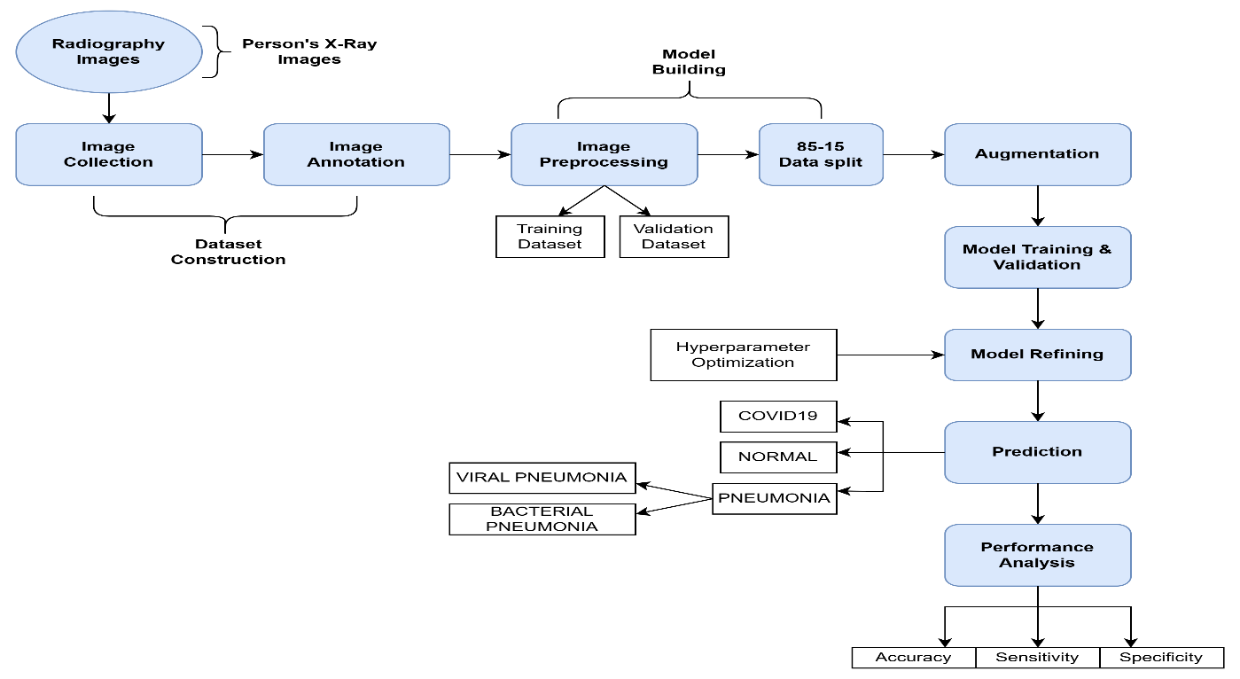
BLOCK DIAGRAM
10-03-2025 Review No.2 Batch No.AG1 Department of CSE

Slide 12
Methodology
Dataset Link: https://drive.google.com/drive/folders/1nQ6TlC0Z4ZJ44psxxezmo5kg7vjjEKDD?usp=drivelink
Number of Classes | 4
Number of Training Images | 42,500 images
Number of Validation Images | 7,500 images
Total Number of Images | 50,000+ images
Algorithms Used:
Rescaling, ConvoNet4.
Frameworks:
Keras, TensorFlow
10-03-2025 Review No.2 Batch No.AG1 Department of CSE

Slide 13
ConvNet4 Architecture
1. Data Preprocessing & Augmentation
Preprocessing Steps includes of the following:
Displaying Random Images
Image Resizing and Normalization
Dataset Splitting (Training, Validation)
Data Augmentation
Goal: Prepare data for efficient and accurate model training.
10-03-2025 Review No.2 Batch No.AG1 Department of CSE

Slide 14
ConvNet4 Architecture
Purpose: Visualize random images from the dataset to verify content and quality.
Explanation:
Folder Iteration: The system scans the dataset directory and lists all subdirectories. Each subdirectory corresponds to a different class of lung conditions.
Image Retrieval: From each subfolder, the system retrieves the first image for display. This ensures representation from every class.
Visualization: Images are displayed individually with their corresponding class (subfolder) name as the title.
Verification: This step checks the integrity and structure of the dataset, ensuring that:
Each class has image data.
There are no empty or corrupted folders.
The dataset is ready for preprocessing and model training.
10-03-2025 Review No.2 Batch No.AG1 Department of CSE

Slide 15
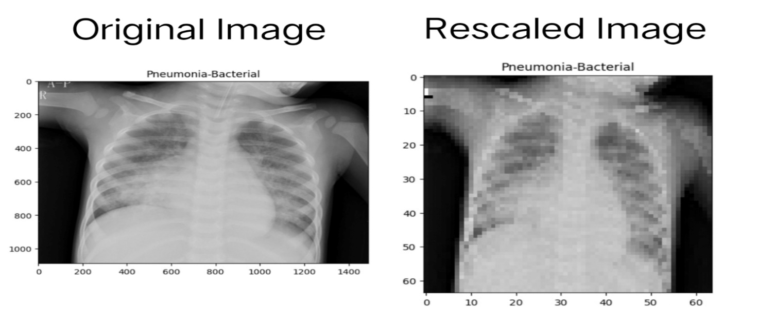
ConvNet4 Architecture
Data Preprocessing & Augmentation
Image Resizing: All chest X-ray (CXR) and CT images are resized to 64×64 pixels.
Normalization: Pixel values are scaled to [0,1] to improve training efficiency.
Data Augmentation: Includes random rotations, translations, shearing, zooming, and horizontal flipping to improve model generalization and prevent overfitting.
10-03-2025 Review No.2 Batch No.AG1 Department of CSE

Slide 16
ConvNet4 Architecture
Data Augmentation:
Purpose:
Increase dataset diversity by applying transformations.
Reduce overfitting by exposing the model to different perspectives of the same data.
Why Augment?:
Limited data can hinder model performance.
Augmentation expands the dataset artificially.
10-03-2025 Review No.2 Batch No.AG1 Department of CSE

Slide 17
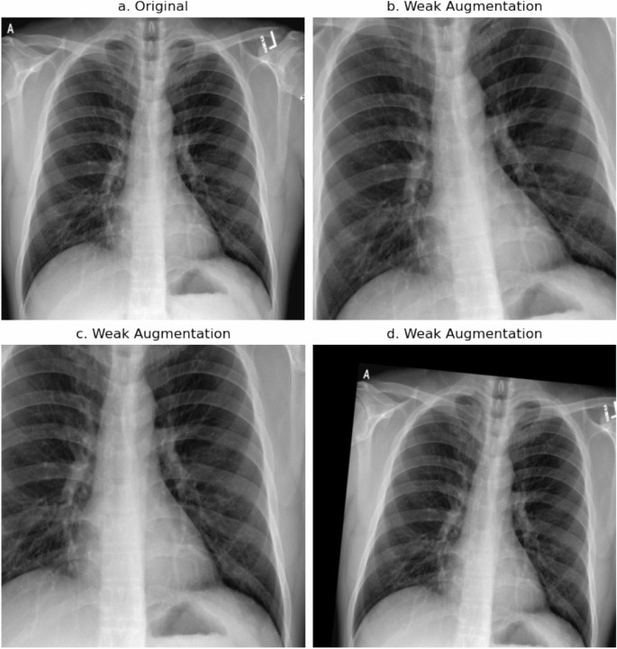
ConvNet4 Architecture
Impact of Data Augmentation
Benefits:
Creates a more diverse dataset.
Reduces overfitting by making
the model robust to variations.
Improves generalization to
unseen data.
Visualization:
Side-by-side comparison
of original and augmented images.
10-03-2025 Review No.2 Batch No.AG1 Department of CSE

Slide 18
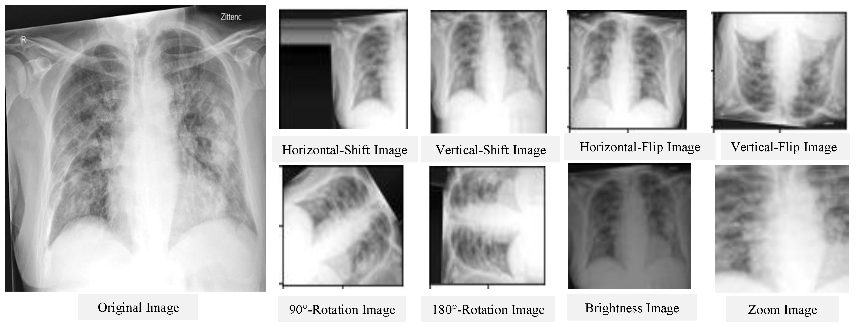
ConvNet4 Architecture
Data Augmentation Implementation
Implementation Strategies:
Augment during model training (real-time augmentation).
Pre-process and save augmented data before training.
Tools:
Keras, ImageDataGenerator or PyTorch augmentation libraries.
10-03-2025 Review No.2 Batch No.AG1 Department of CSE

Slide 19
ConvNet4 Architecture
2. Model Architecture
Layer | Type | Output Shape | Parameters
Input Layer | Grayscale Image | (64,64,1) | 0
Conv2D-1 | 32 Filters, 3×3 Kernel, ReLU | (62,62,32) | 320
MaxPooling2D-1 | 2×2 Pooling | (31,31,32) | 0
Conv2D-2 | 64 Filters, 3×3 Kernel, ReLU | (29,29,64) | 18496
MaxPooling2D-2 | 2×2 Pooling | (14,14,64) | 0
Flatten Layer | Converts 3D Matrix to 1D | (12544,) | 0
Dense Layer-1 | Fully Connected (128 Neurons, ReLU) | (128,) | 1,606,080
Dropout | Regularization (Dropout Rate: 0.5) | (128,) | 0
Output Layer | Softmax Activation (4 Classes) | (4,) | 387
10-03-2025 Review No.2 Batch No.AG1 Department of CSE

Slide 20
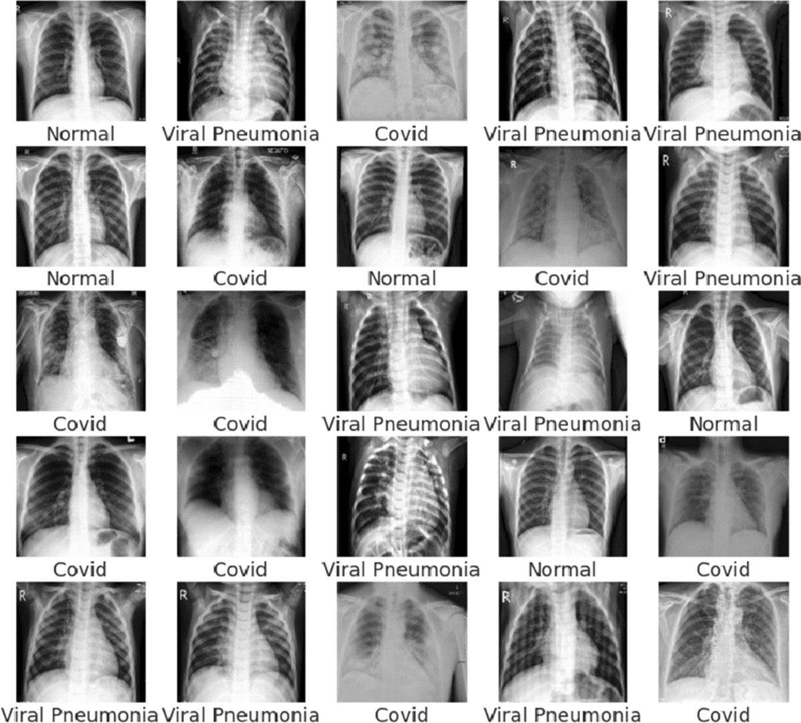
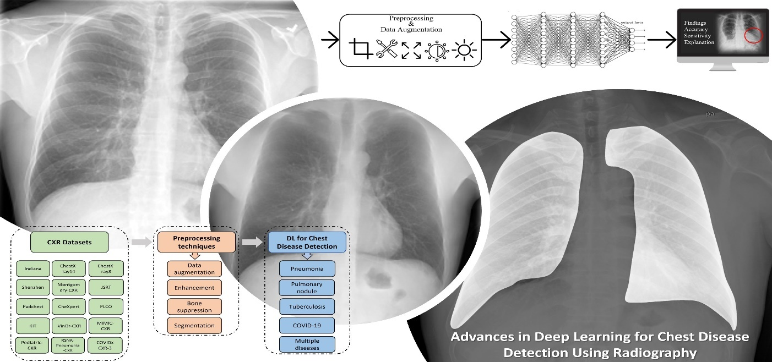
ConvNet4 Architecture
3. Training & Optimization
Loss Function: Categorical Cross-Entropy
Optimizer: Adam
Performance Metrics: Accuracy, Precision, Recall, F1-score
Validation Split: 85% Training, 15% Testing
10-03-2025 Review No.2 Batch No.AG1 Department of CSE

Slide 21
Implementation
Hardware Requirements:
GPU: NVIDIA RTX 3090 (or equivalent) with at least 24GB memory.
CPU: Intel Core i9 or AMD Ryzen 9.
RAM: Minimum 32GB.
Storage: 1TB SSD for fast data read/write operations.
Additional: UPS (Uninterruptible Power Supply) for power protection.
Software Requirements:
Operating System: Ubuntu 20.04 or Windows 10
Programming Language: Python 3.8+.
Frameworks:
TensorFlow 2.8+.
Keras for model building.
10-03-2025 Review No.2 Batch No.AG1 Department of CSE

Slide 22
Challenges
Challenge 1: Imbalanced Dataset
Solution: Data augmentation techniques like oversampling underrepresented classes.
Challenge 2: Overfitting
Solution:
Dropout layers.
Data augmentation.
Early stopping based on validation performance.
Challenge 3: High Computational Cost
Solution:
Model pruning and compression.
Use of lightweight architectures for deployment.
10-03-2025 Review No.2 Batch No.AG1 Department of CSE

Slide 23
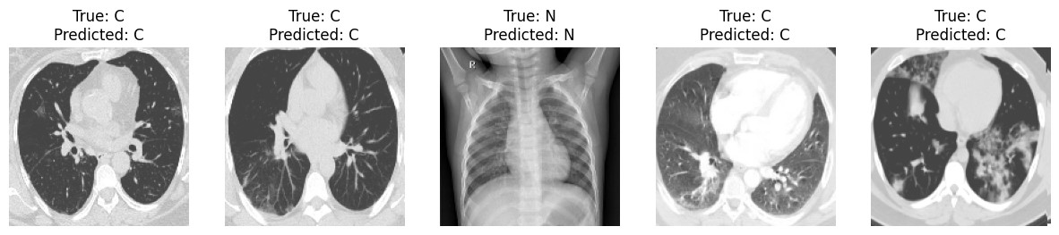
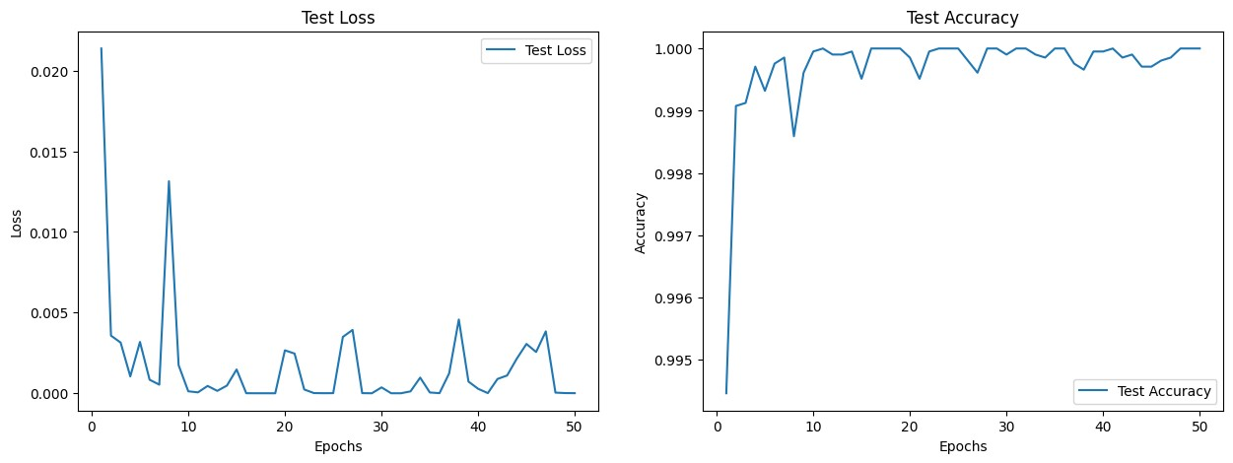
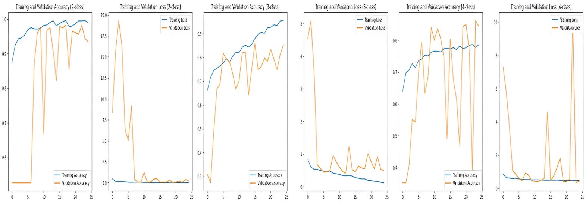
RESULT & ANALYSIS
10-03-2025 Review No.2 Batch No.AG1 Department of CSE

Slide 24
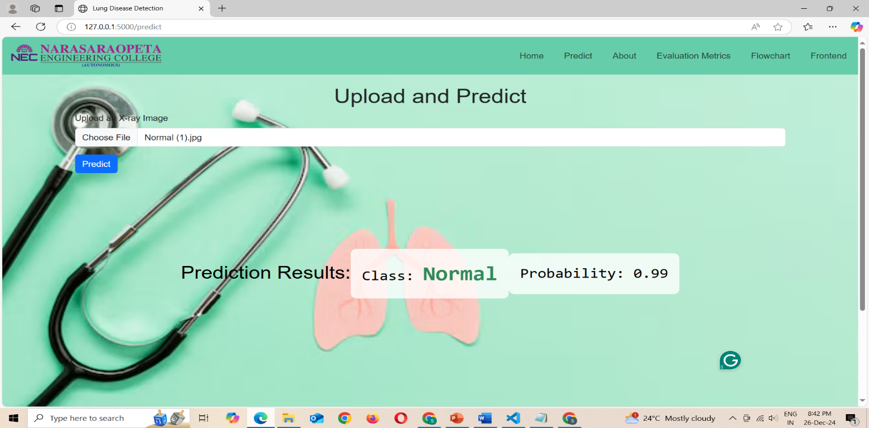
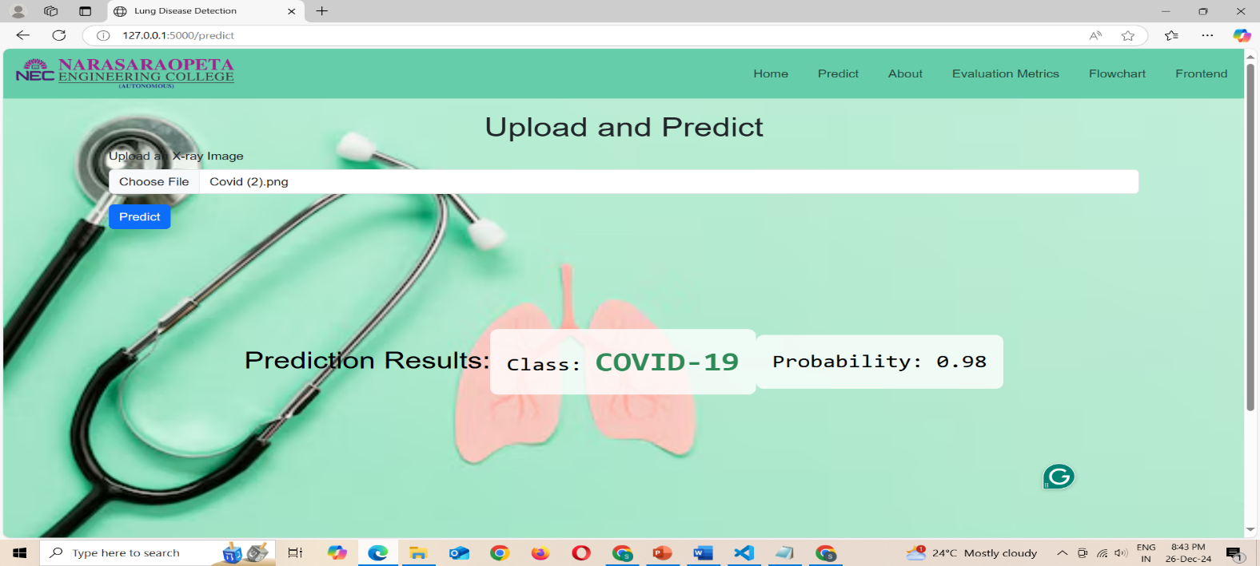
RESULT & ANALYSIS
10-03-2025 Review No.2 Batch No.AG1 Department of CSE

Slide 25
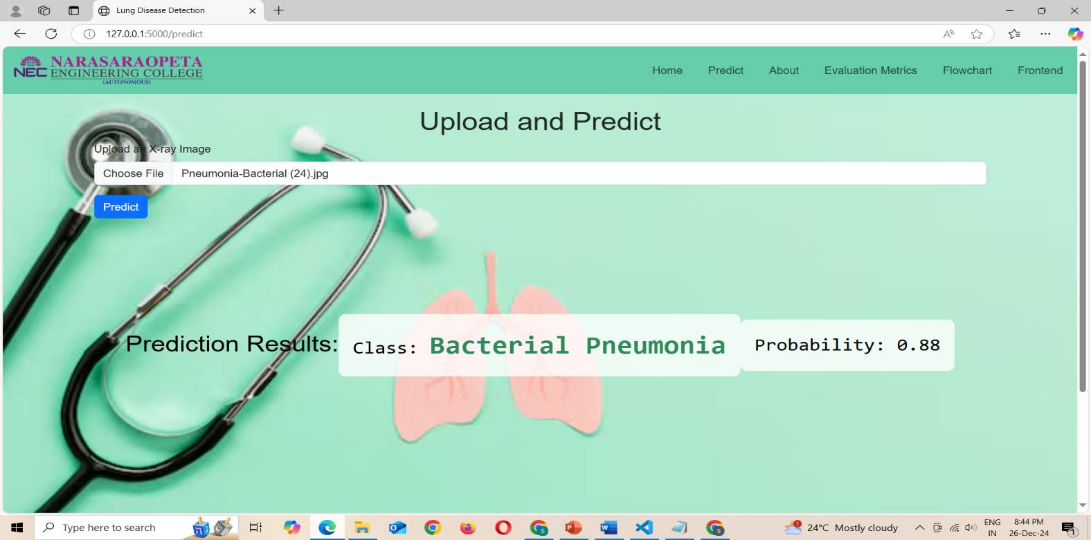
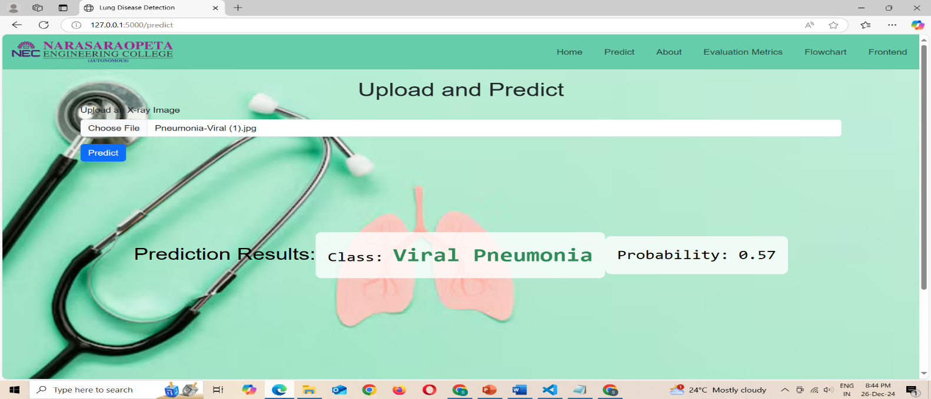
RESULT & ANALYSIS
10-03-2025 Review No.2 Batch No.AG1 Department of CSE

Slide 26
Conclusion and Future Scope
In this investigation, they show that deep learning can be applied to pulmonary illness detection even for healthcare. An optimized convolutional neural network architecture was used which made it to become very accurate and specialized in multiple forms of breathing organ illnesses including Normal or Healthy, SARS-CoV-2, Bacterial pneumonitis as well as Viral pneumonitis. To address class unbalance and consequently improve the trustworthiness of the system for real life, modern data augmentation techniques were employed. Therefore this highlights how deep learning will revolutionize diagnostic possibilities finally leading towards better and dependable healthcare system formats meant for respiratory conditions.
Future work should focus on diverse datasets, integrating deep learning into radiology, leveraging explainable AI, and incorporating patient history to enhance diagnostic precision and healthcare applications.
10-03-2025 Review No.2 Batch No.AG1 Department of CSE

Slide 27
REFERENCES
[1] Zhou, S. K., Greenspan, H., Davatzikos, C., Duncan, J. S., van Ginneken, B., Madabhushi, A., Prince, J. L., Rueckert, D., Summers, R. M., “A Review of Deep Learning in Medical Imaging: Imaging Traits, Technology Trends, Case Studies With Progress Highlights, and Future Promises,” IEEE, pp. 820-838, 2021.
[2] Koupaei, M., Naimi, A., Moafi, N., Mohammadi, P., Sadat Tabatabaei, F., Ghazizadeh, S., Heidary, M., Khoshnood, S., “Clinical Characteristics, Diagnosis, Treatment, and Mortality Rate of TB/COVID-19 Coinfected Patients: A Systematic Review,” Frontiers in Medicine, vol. 8, 2021. Available: https://doi.org/10.3389/fmed.2021.740593.
[3] Swets, J. A., Evaluation of Diagnostic Systems, New York: Academic Press, 2012.
[4] Seyhan, A. A., Carini, C., “Are innovation and new technologies in precision medicine paving a new era in patient-centric care?” Journal of Translational Medicine, vol. 17, no. 114, 2019. Available: https://doi.org/10.1186/s12967-019-1864-9.
[5] Cozzi, D., Bicci, E., Bindi, A., Cavigli, E., Danti, G., Galluzzo, M., Granata, V., Pradella, S., Trinci, M., Miele, V., “Role of Chest Imaging in Viral Lung Diseases,” International Journal of Environmental Research and Public Health, vol. 18, no. 12, p. 6434, 2021. Available: https://doi.org/10.3390/ijerph18126434.
10-03-2025 Review No.2 Batch No.AG1 Department of CSE

Slide 28
[6] Abdulrahman, A., “PulmoNet: A Novel Deep Learning-Based Pulmonary Diseases Detection Model,” Kaggle, 2024. Available: https://www.kaggle.com/datasets/abdulahiabdulrahman/pulmonet dataset.
[7]Rahman, T., “A Multiclass Deep Learning Algorithm for Healthy Lung, Covid-19, and Pneumonia Disease Detection from Chest X-Ray Images,” Kaggle, 2024.
Available: https://www.kaggle.com/datasets/tawsifurrahman/COVID19 radiography-database.
[8] Mooney, P. T., “Contribution to Pulmonary Diseases Diagnostic from X-Ray Images Using Innovative Deep Learning Models,” Kaggle, 2024.
Available: https://www.kaggle.com/datasets/tawsifurrahman/covid19 radiography-database.
[9] Blanche, L., “Deep Convolution Neural Network for Respiratory Diseases Detection Using Radiology Images,” Kaggle, 2023.
Available: https://www.kaggle.com/datasets/luisblanche/covidct?select=CTCOV ID.
[10] Kermany, D., “An Efficient Deep-Learning Model to Diagnose Lung Diseases Using X-Ray Images,” Kaggle, 2023. Available: https://www.kaggle.com/datasets/prashant268/chest-xray-covid19 pneumonia.
10-03-2025 Review No.2 Batch No.AG1 Department of CSE

Slide 29
[11] Abd El-Monem, M., “DarkCVNet: Optimized Pneumonia and COVID-19 Detection Using CXR Images,” Kaggle, 2022. Available: https://www.kaggle.com/datasets/plameneduardo/sarscov2-ctscan dataset.
[12]Rahman, T., “Pulmonary Diseases Decision Support System Using Deep Learning Approach,” Kaggle, 2022. Available: https://www.kaggle.com/datasets/tawsifurrahman/covid19-radiography database.
[13] Elbaz, M., “Diagnosing and Differentiating Viral Pneumonia and COVID-19 Using X-Ray Images,” Kaggle, 2022. Available: https://www.kaggle.com/datasets/tawsifurrahman/covid19-radiography database.
[14] SIRM Radiology Society, “Analysis of COVID-19 and Pneumonia Detection in Chest X-Ray Images Using Deep Learning,” Italian Society of Medical and Interventional Radiology (SIRM), 2021.
[15] Razi, K., “Comparative Analysis of Deep Learning Models for Detection of COVID-19 from Chest X-Ray Images,” Kaggle, 2020.
Available: https://www.kaggle.com/datasets/pranavraikokte/covid19-image-dataset
10-03-2025 Review No.2 Batch No.AG1 Department of CSE

Slide 30

10-03-2025 Review No.2 Batch No.AG1 Department of CSE

Slide 31
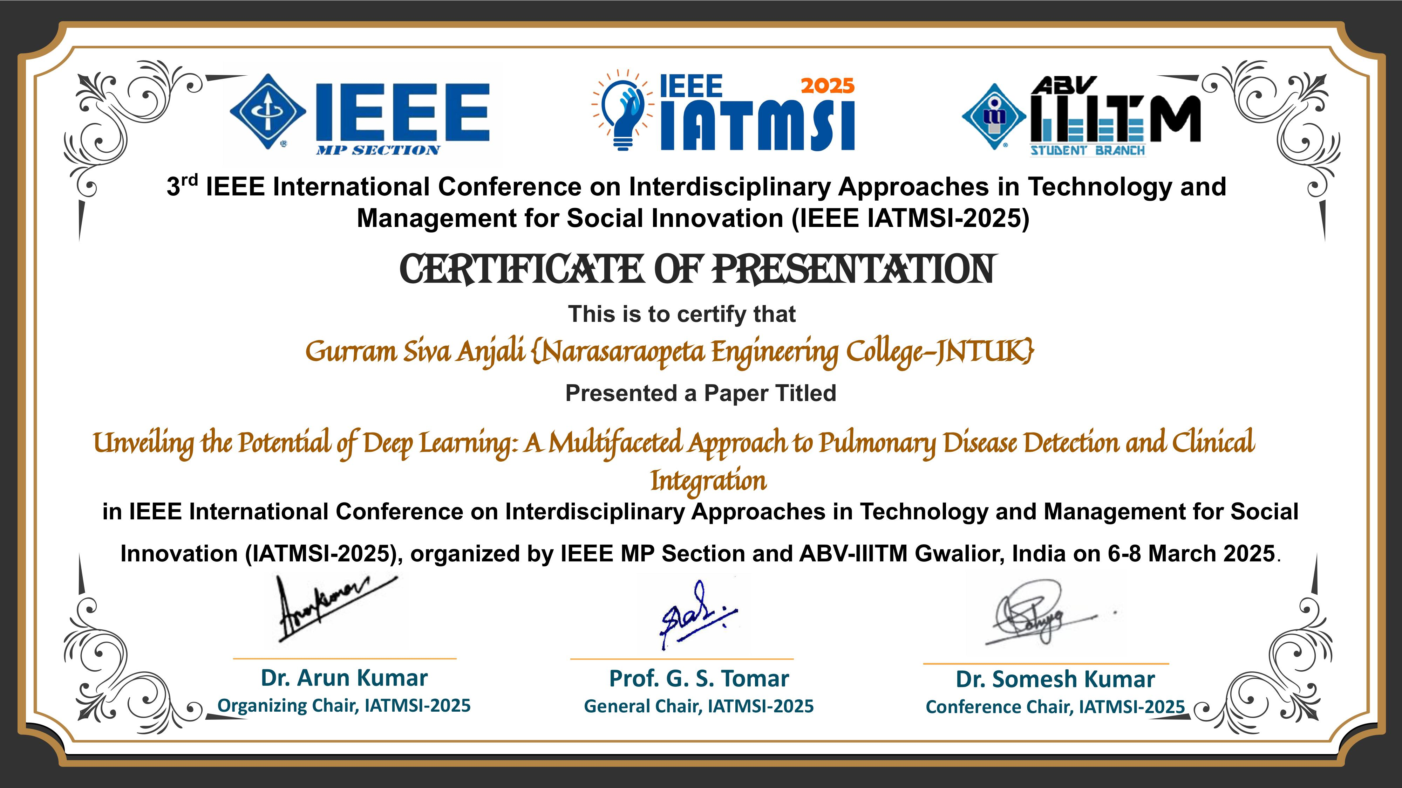
10-03-2025 Review No.2 Batch No.AG1 Department of CSE

Slide 32

10-03-2025 Review No.2 Batch No.AG1 Department of CSE

